Slide 1


Astrodynamics Specialist Conference 2026, Whistler, BC
AAS 26-967
Sun-Earth L₂ Point Nulling Interferometry Formation Flying Performance Analysis
Aiden Weatherbee
MSc Student, Astronautics and Robotics Laboratory (ASTRO Lab), Department of Physics & Astronomy,
York University, Email: aidenweatherbee@hotmail.com
Sarah Rugheimer
Associate Professor, Department of Physics & Astronomy, York University; Reader, University of Edinburgh
Email: srughei@ed.ac.uk
Michael C.F. Bazzocchi
Associate Professor, Astronautics and Robotics Laboratory (ASTRO Lab),
Department of Earth & Space Science & Engineering, York University, Email: mbazz@yorku.ca
Notes:
HI everyone, my name is aiden Weatherbee. Today ill be talking about a 144 case trade study for a formation flying nulling interferometer concept at the sun-earth l2 point.

Slide 2
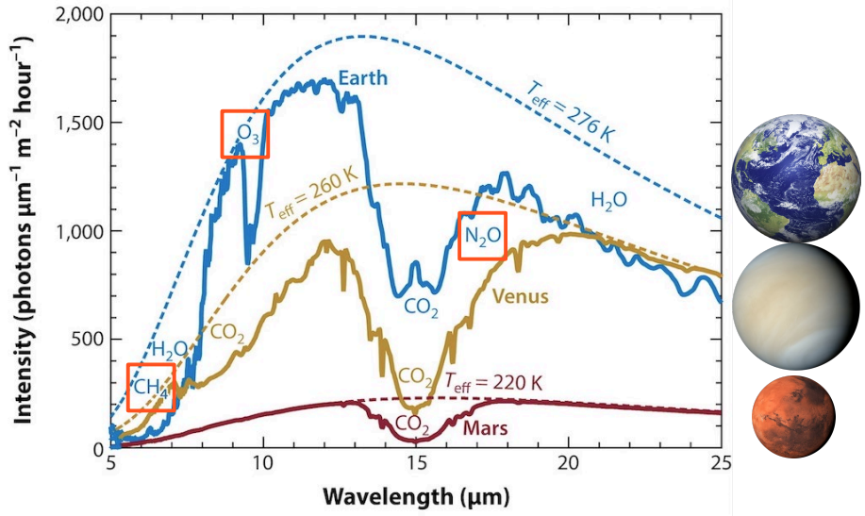
Introduction
Background
Problem
Methodology
Results
Conclusion
The Goal: Characterize Terrestrial Worlds with LIFE
Wavelength covers peak emission of Earth-like exoplanets
Features absorption bands of O3, CH4, N2O
Thermal emission carries atmospheric information
(Credit: Meadows and Crisp, 1996; Tinetti et al., 2005; Tinetti et al., 2006; Kaltenegger et al., 2007; Selsis et al., 2007b)
Notes:
So to start off im going to give you an introduction to why nulling interferometry is appealing. A central concern of modern astrophysics is to directly image temperate terrestrial worlds. The LIFE mission- which stands for Large Interferometer For Exoplanets- is a formation flying nulling interferometer concept that aims to do this by the 2040’s. A key reason that this mission is wanted by the community is that it can null the starlight to access the planets mid infrared thermal emission , which contains key habitability indicators of interest such as ozone, methane, and nitrous oxide

Slide 3
Introduction
Background
Problem
Methodology
Results
Conclusion
For a nulling interferometer (e.g., LIFE) there are several mission level design variables that affect the design of both the formation control and the optics.
We study the relative formation error and fuel usage of these key variables.
Formation control and optical control must be co-designed: formation errors couple directly into nulling and modulation errors.

Slide 4
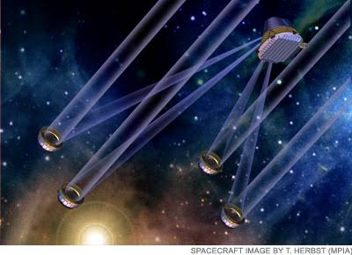
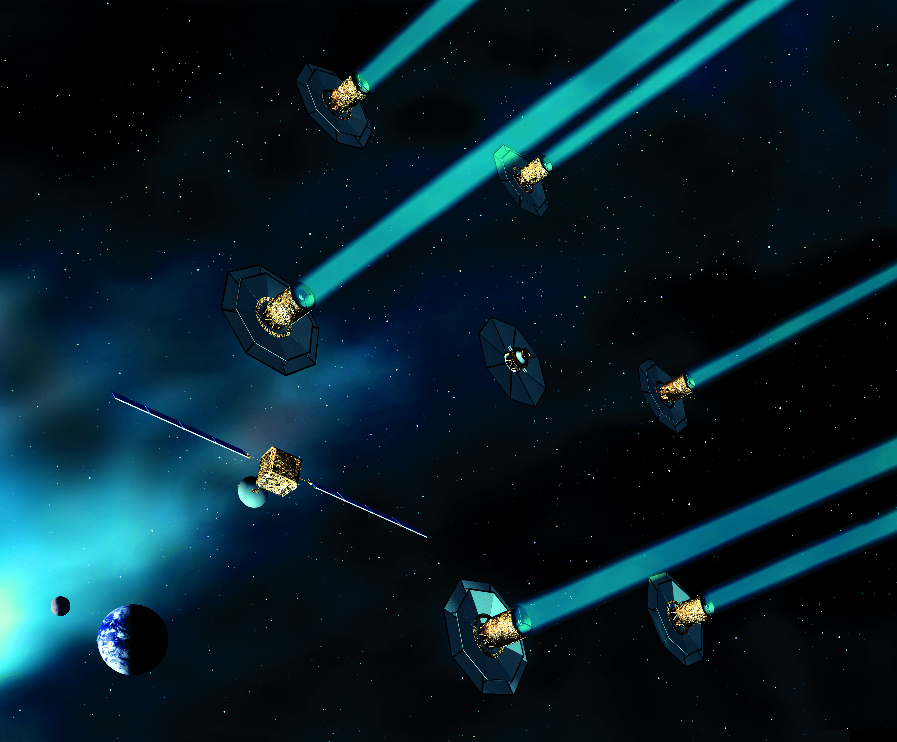
Introduction
Background
Problem
Methodology
Results
Conclusion
https://www.esa.int/Enabling_Support/Space_Engineering_Technology/Proba-3
Past Concepts:
https://www.astro.princeton.edu/~dns/FRS120/RFI/134_TPF-I_Lawson_EOS.pdf
https://slab.stanford.edu/projects/stari
TPFI (credit: NASA)
Formation Flying:https://www.esa.int/ESA_Multimedia/Images/2015/06/Darwin_s_six_telescopes
https://science.nasa.gov/mission/grace-fo/
DARWIN (credit: ESA)
4
Notes:
For a bit of context, LIFE is actually inspired by past nulling interferometer concepts- NASA’S TPFI and ESA’S DARWIN. These missions were cancelled due to unknown mission yields, which has since been answered, and immature formation flying

Slide 5
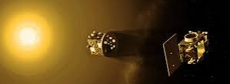
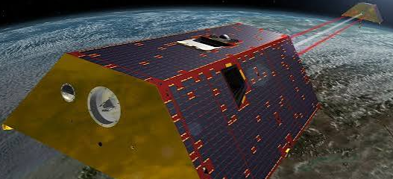
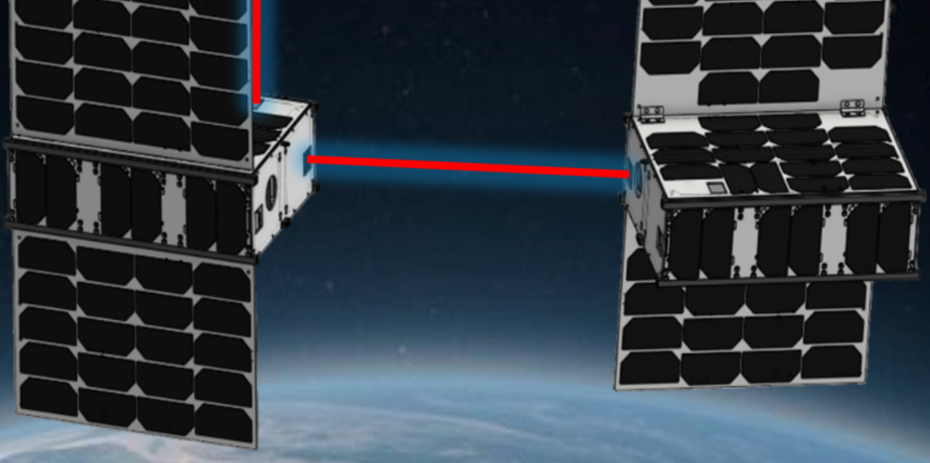
Introduction
Background
Problem
Methodology
Results
Conclusion
https://www.esa.int/Enabling_Support/Space_Engineering_Technology/Proba-3
Past Concepts:
Past/Future Tech Demos:
https://www.astro.princeton.edu/~dns/FRS120/RFI/134_TPF-I_Lawson_EOS.pdf
Proba-3 (credit: ESA)
https://slab.stanford.edu/projects/stari
TPFI (credit: NASA)
Formation Flying:https://www.esa.int/ESA_Multimedia/Images/2015/06/Darwin_s_six_telescopes
GRACE-FO (credit: NASA)
https://science.nasa.gov/mission/grace-fo/
DARWIN (credit: ESA)
STARI (credit: Stanford SRL)
4
Notes:
There have since been several missions that have tackled the formation flying issue such as proba 3 and grace-fo.

Slide 6
Introduction
Background
Problem
Methodology
Results
Conclusion
https://www.esa.int/Enabling_Support/Space_Engineering_Technology/Proba-3
Past Concepts:
Past/Future Tech Demos:
Inspiration in this Study:
https://www.astro.princeton.edu/~dns/FRS120/RFI/134_TPF-I_Lawson_EOS.pdf
In-plane vs Out-of-plane
(TPFI vs Darwin)
12,18, 24 hour rotation rates (TPFI vs LIFE vs Darwin)
45, 65, 85 degree pointing angle (TPFI/LIFE/Darwin inspired)
Sensors inspired by Proba-3, GRACE-FO, and STARI
Proba-3 (credit: ESA)
https://slab.stanford.edu/projects/stari
TPFI (credit: NASA)
Formation Flying:https://www.esa.int/ESA_Multimedia/Images/2015/06/Darwin_s_six_telescopes
GRACE-FO (credit: NASA)
https://science.nasa.gov/mission/grace-fo/
DARWIN (credit: ESA)
STARI (credit: Stanford SRL)
4
Notes:
All of these missions have inspired this trade study through the trade variables and sensor models.

Slide 7
Introduction
Background
Problem
Methodology
Results
Conclusion
Nulling Interferometry
Planet
Star
Combiner
Telescope 1
Telescope 2
Telescope 3
Telescope 4
Notes:
Before I go any farther into my trade study, I want you to understand how nulling interferometry works so you can understand the results. So the fundamental idea is that you can take multiple mirrors on separate spacecraft and combine the light inside a separate combiner spacecraft. This allows you to achieve the resolution needed to distinguish the star from the planet in the mid infrared wavelengths. Think of it like taking jwst’s hexagonal segments and separating them to increase its resolution.

Slide 8
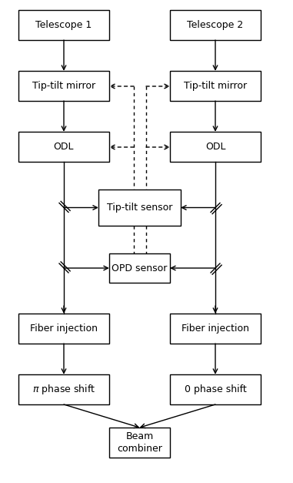
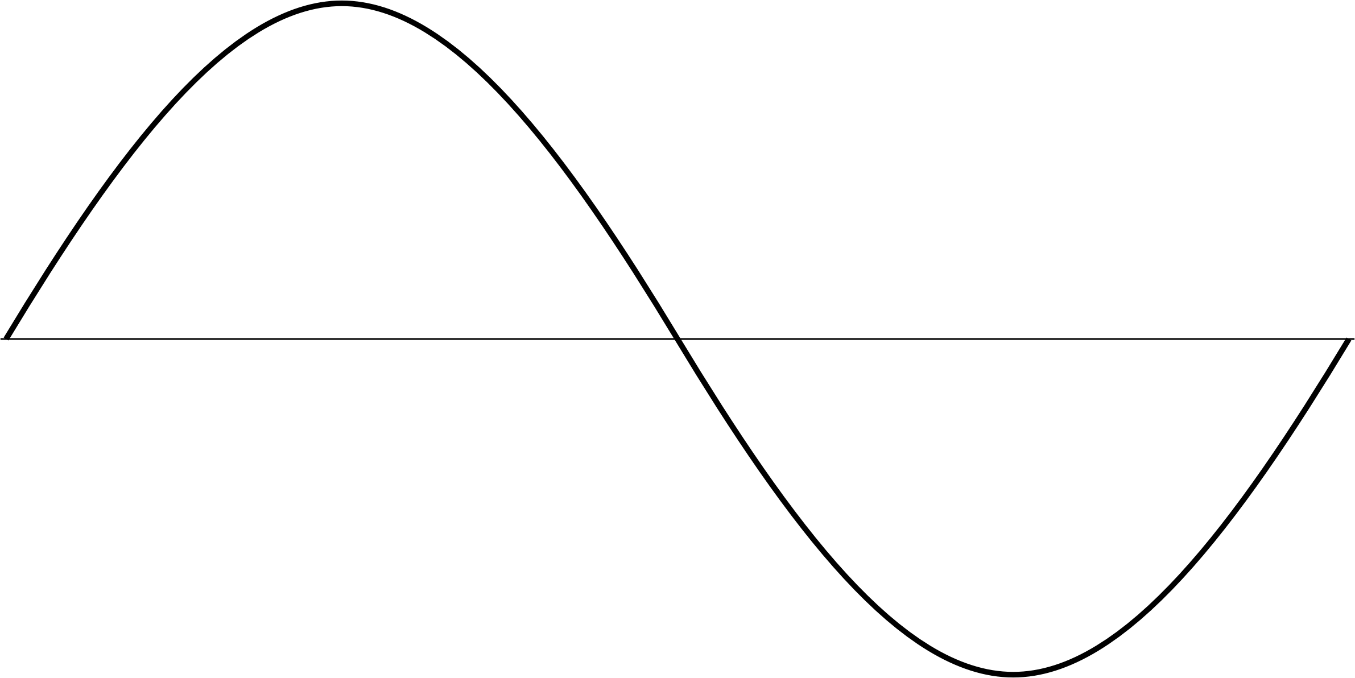
Introduction
Background
Problem
Methodology
Results
Conclusion
Nulling Interferometry
x2
Planet
Star
Combiner
Telescope 1
Telescope 2
Telescope 3
Telescope 4
Notes:
The formation is expected to stay close to ridged, so the combiner spacecraft then has controllable optics that corrects for errors in formation control that cause tip/tilt and optical path difference errors. In the light beam.
This is then injected into fibre optic cables where a pi phase shift is applied, and the beams are combined. The pi phase shift is what causes the nulling of the star.

Slide 9
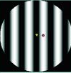
Introduction
Background
Problem
Methodology
Results
Conclusion
Nulling Interferometry
x2
Planet
Star
Combiner
Telescope 1
Telescope 2
Telescope 3
Telescope 4
Notes:
You then rotate the array to modulate the planets signal through the dark and light fringes, while the on axis star remains destructively interfered in the dark fringe.

Slide 10
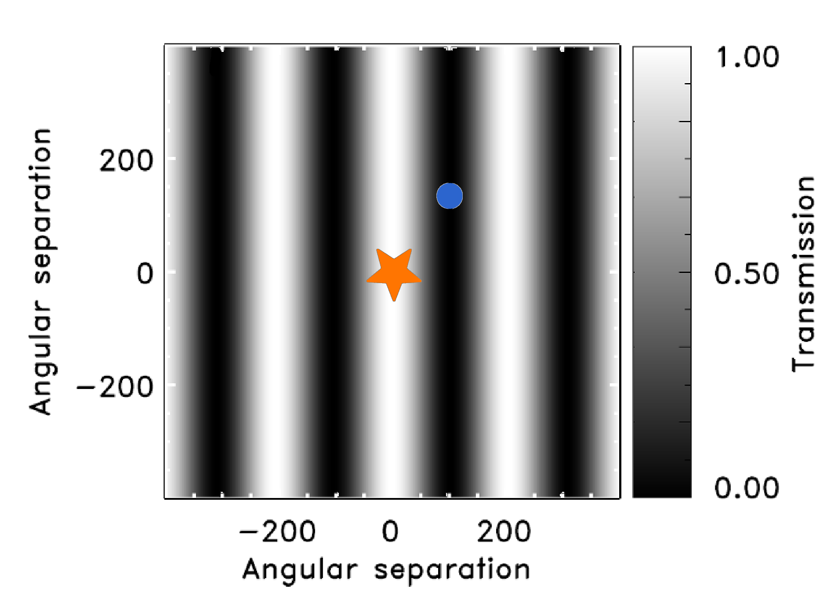
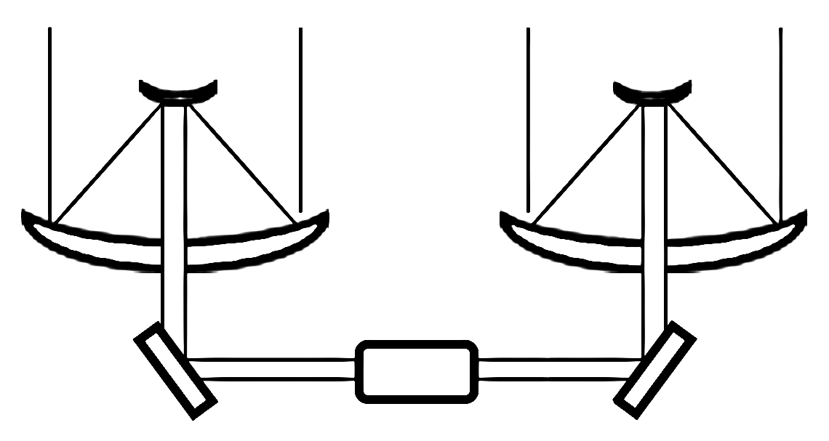
Introduction
Background
Problem
Methodology
Results
Conclusion
Star
Planet
Imaging Interferometer
D. Rouan
Combiner Spacecraft
Notes:
A key thing I want to highlight is that the nulling of the star relies on the ability to control the optical beam to within a pi phase shift of light. This is what distinguishes a nulling interferometer from an imaging interferometer.

Slide 11
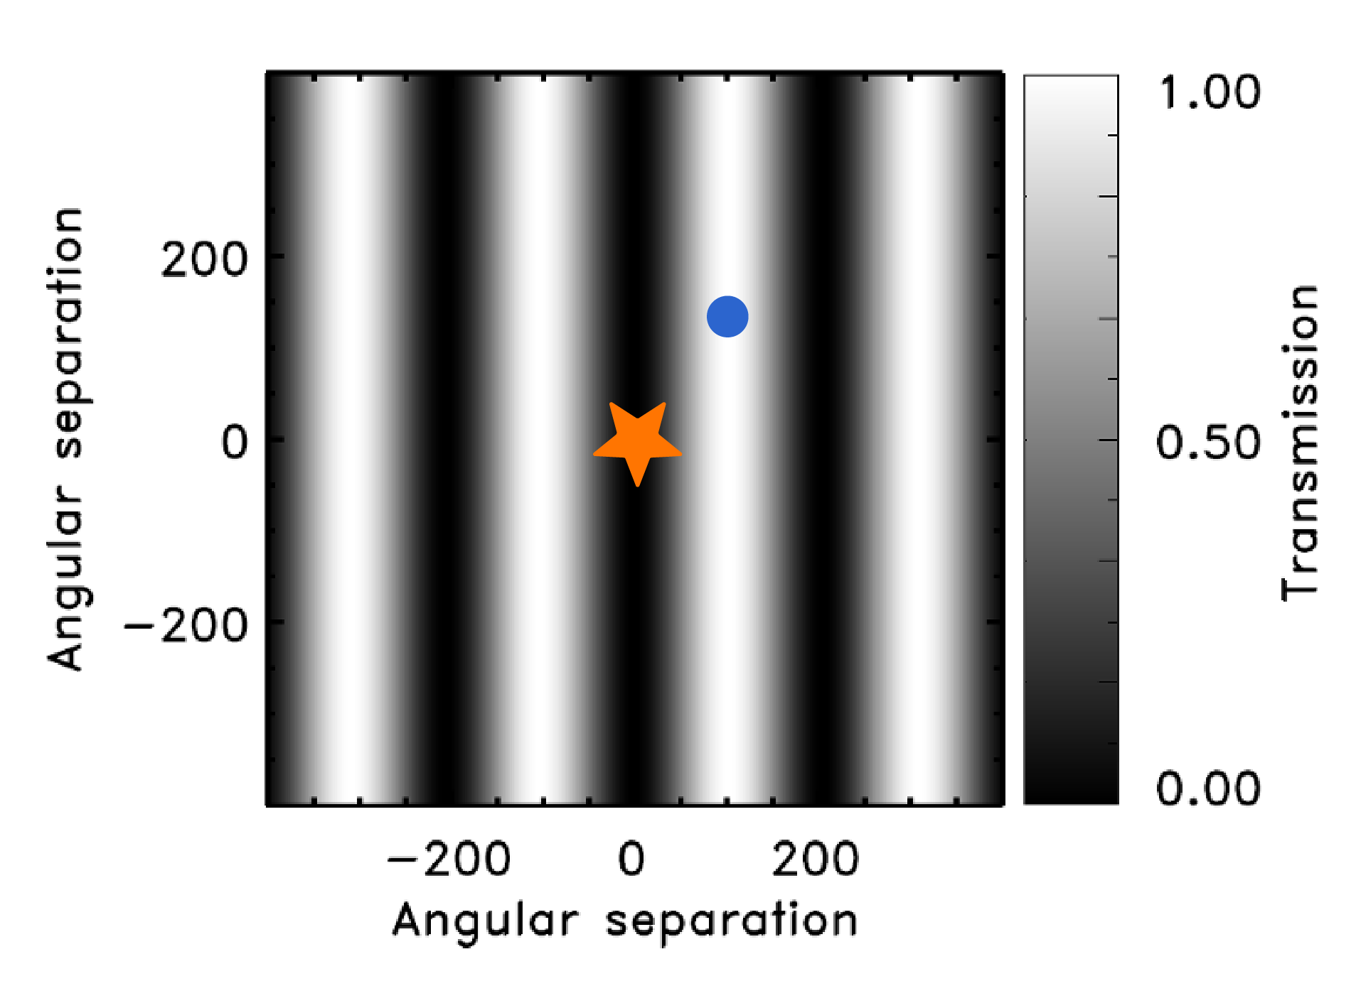
Introduction
Background
Problem
Methodology
Results
Conclusion
Star
Planet
Nulling Interferometer
D. Rouan
Combiner Spacecraft
Pi Phase Inversion
Notes:
The achromatic pi phase shift is what holds the dark fringe. The star is expected to be on the order of 1 billion times brighter than the planet, so even a small break in this control can completely overwhelm the planets signal.

Slide 12

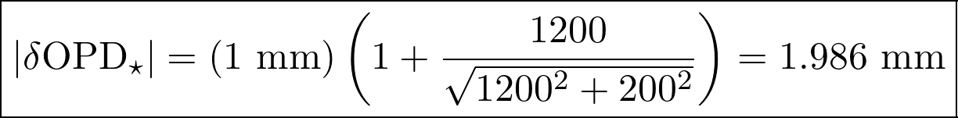
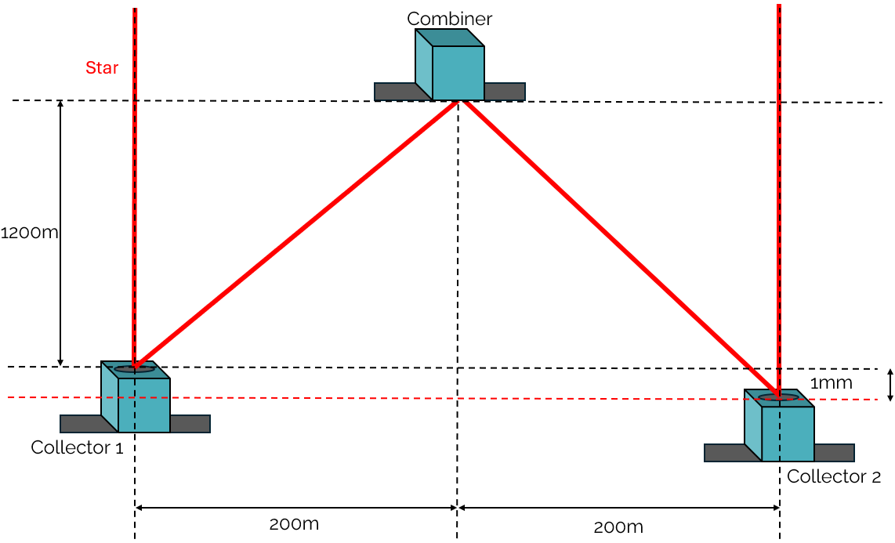
Introduction
Background
Problem
Methodology
Results
Conclusion
Optical Path Difference / Phase Mismatch
Notes:
This makes holding the optical path difference the central concern of nulling interferometry. This figure shows how a 1 mm error along LOS can result in a roughly 2 mm OPD error, which corresponds to 200 wavelengths of light at 10 micrometers.

Slide 13

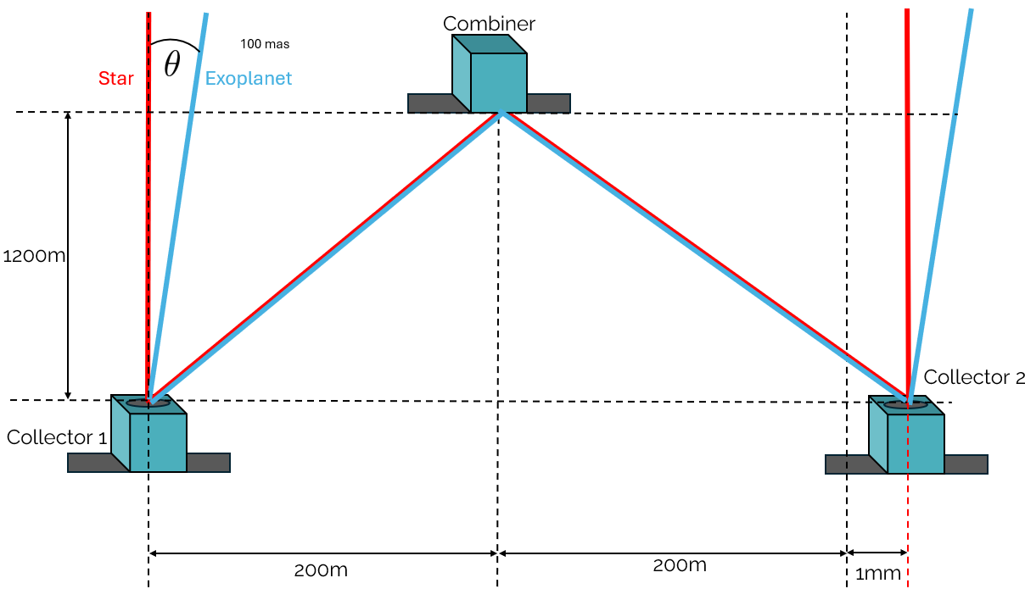
Introduction
Background
Problem
Methodology
Results
Conclusion
Optical Path Difference / Phase Mismatch
Planet Modulation Error
Notes:
Cross LOS errors can also cause Planet Modulation errors, which shifts the exoplanets signal within the spectrum, making it harder to detect from background noise. Really the point of this is to show that the formation control system is directly coupled to the optical control system, directly affecting the scientific yield.

Slide 14
Introduction
Background
Problem
Methodology
Results
Conclusion
144 Case Trade Study Variables
2 x Controller
PD vs CR3BP-LQI
8
Notes:
That brings us to this trade study. As mentioned, this is a 144 case trade study that varies key mission level design choices that affect both the optical control system and the formation and attitude control systems. So we test 2 difference controllers- a simple PD , and a cr3bp based linear quadratic integrator.

Slide 15
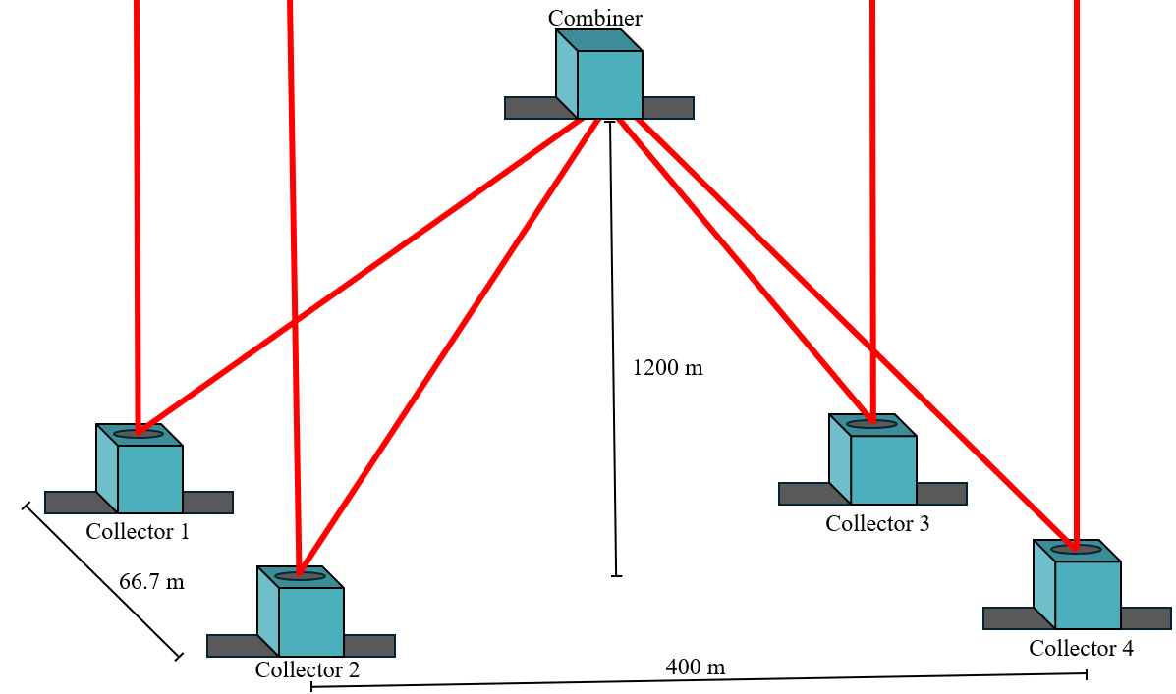
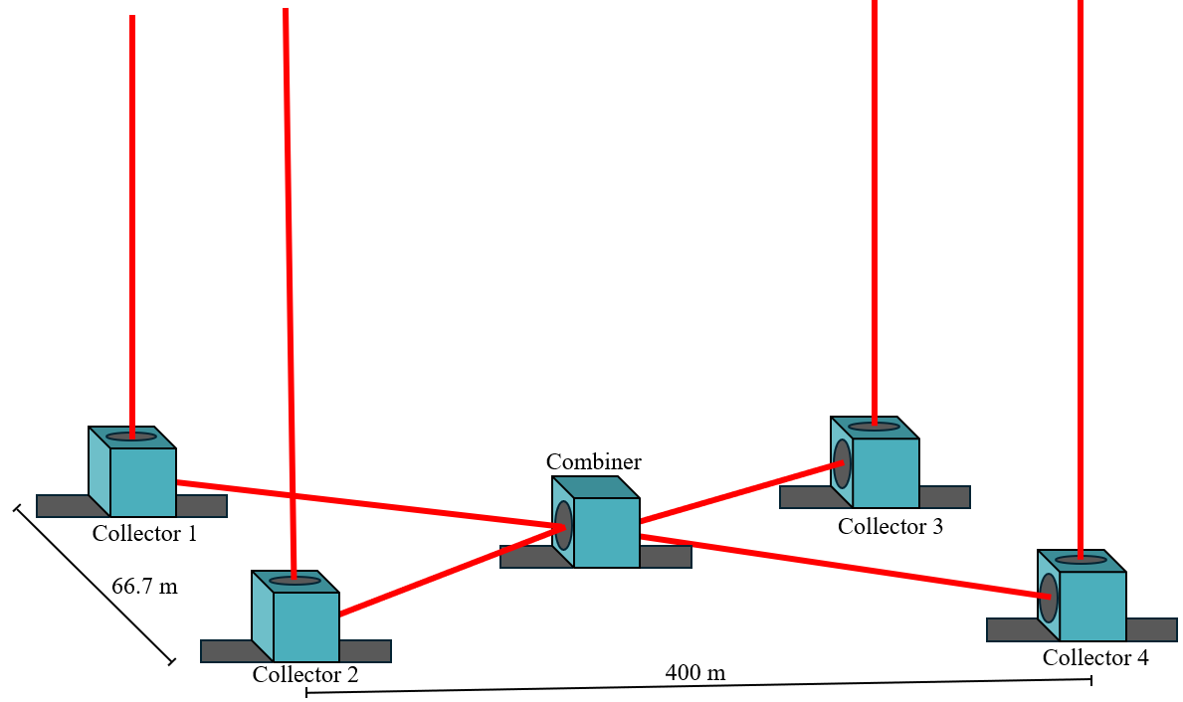
Introduction
Background
Problem
Methodology
Results
Conclusion
144 Case Trade Study Variables
2 x Controller
PD vs CR3BP-LQI
2 x Combiner placement
In-plane combiner vs out-of-plane combiner
8
Notes:
WE test the 2 different chief placements that Life is considering, inspired by TPFI and Darwin, which is in plane vs out of plane shown on the side there

Slide 16
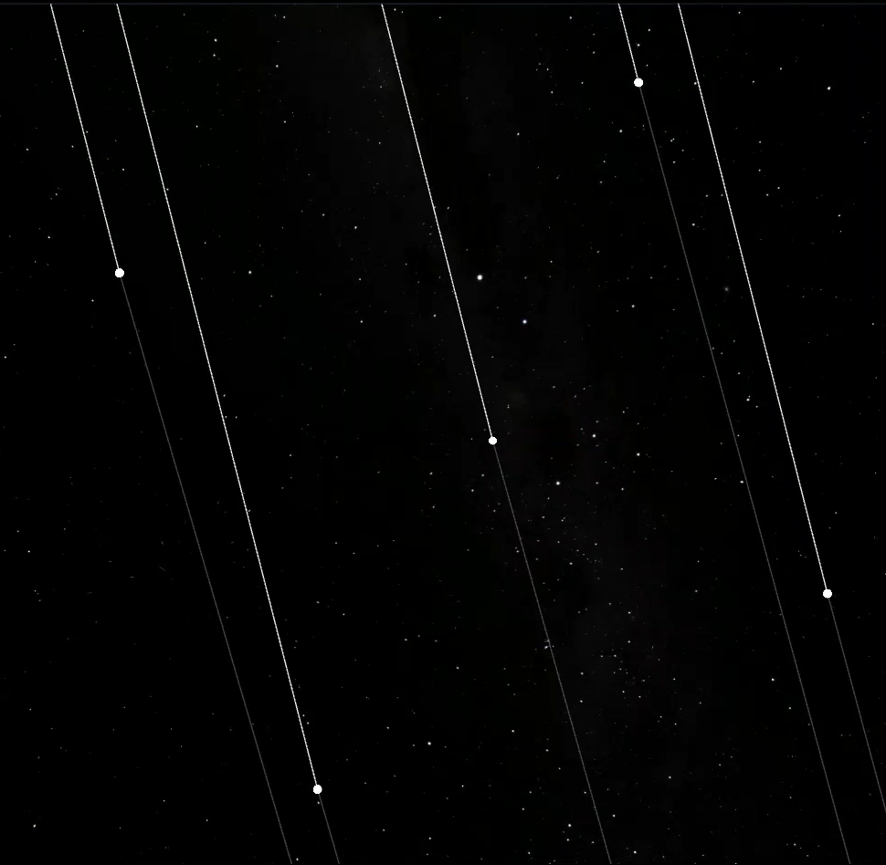
Introduction
Background
Problem
Methodology
Results
Conclusion
144 Case Trade Study Variables
2 x Controller
PD vs CR3BP-LQI
2 x Combiner placement
In-plane combiner vs out-of-plane combiner
3 x Array rotation
12 h, 18 h, 24 h array-rotation periods
8
Notes:
We test the 3 array rotation periods of again TPFI, LIFE, and DARWIN

Slide 17
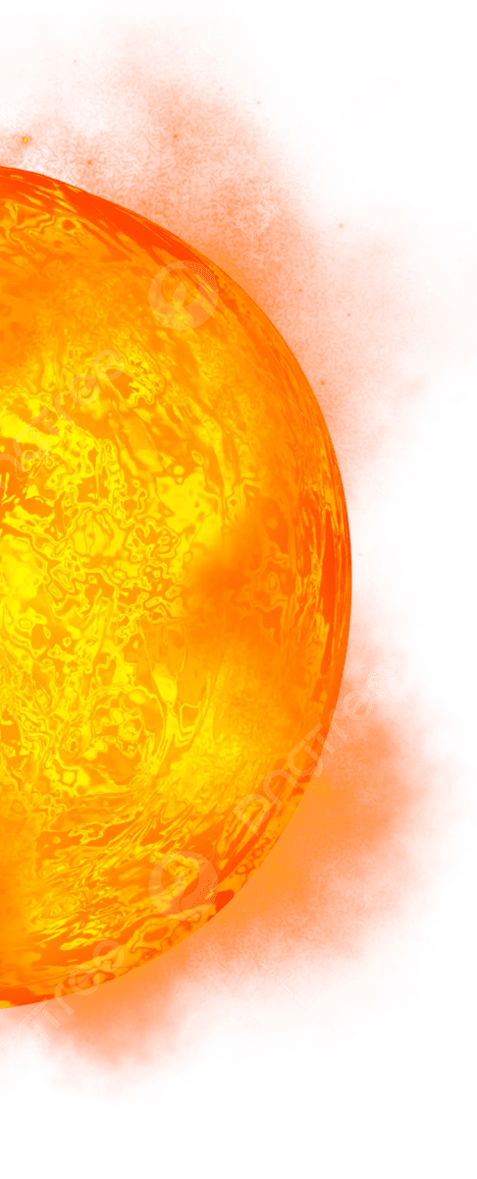

Introduction
Background
Problem
Methodology
Results
Conclusion
144 Case Trade Study Variables
2 x Controller
PD vs CR3BP-LQI
2 x Combiner placement
In-plane combiner vs out-of-plane combiner
3 x Array rotation
12 h, 18 h, 24 h array-rotation periods
3 x Pointing angle
45°, 65°, 85° line-of-sight cases
8
Notes:
And then to ensure these results are robust over the expected array orientations, we test across the range of viable viewing angles with 45 degrees, 65 degrees, and 85 degrees with respect to the sun-earth line.

Slide 18
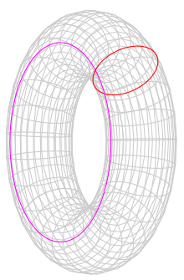
Introduction
Background
Problem
Methodology
Results
Conclusion
144 Case Trade Study Variables
2 x Controller
PD vs CR3BP-LQI
2 x Combiner placement
In-plane combiner vs out-of-plane combiner
3 x Array rotation
12 h, 18 h, 24 h array-rotation periods
3 x Pointing angle
45°, 65°, 85° line-of-sight cases
4 x Combiner orbit
JWST-like halo; small periodic halo; quasi-halo; Lissajous-family trajectory
8
8
Notes:
This is also tested across 4 different L2 orbit types, as L2 is a quite chaotic regime, these 4 orbit types were chosen as a representative wide spread of initial orbit conditions to ensure the results remain robust.
Everything else remains fixed, and this gives us the 144 cases.

Slide 19
Introduction
Background
Problem
Methodology
Results
Conclusion
Follower Spacecraft Control System
Sensors/Commanded states
New attitude
Attitude Sensors
-Star tracker
-IMU
Delivered torque
Attitude estimate
Attitude Estimation
-MRP square root UKF
Attitude Control
-MRP PD feedback
Wheel Allocation
-Least squares allocation
-4 Reaction wheels
Attitude error
Requested torque
Delivered torque
Commanded States
-Target attitude
-Target position
-Chief inertial pose
6-DOF RK7(8) ephemeris propagation
Commanded position & attitude
Thruster torque
Position Estimation
-CR3BP nonlinear square root EKF
Position Control
-CR3BP LQI
or
-PD
Thruster Allocation
-Convex allocation
-12 Thrusters
Position Sensors
-Laser metrology
-Inter-Satellite link
-LED-camera link
Position/ velocity
error
Requested force
Delivered force and torque
Range & angle estimates
Delivered force
New relative state
Notes:
So ive convinced you that errors on the order of sub mm are of interest,so I think the next task is to convince you that my simulation can actually capture that. This is a diagram of the follower control system that I simulate.
So highlighted in the red box you can see the sensors and commanded states that the followers receive at varying rates, including a star tracker, imu, laser metrology, a camera-LED link, and an inter satellite link to receive the commanded and chief states.

Slide 20
Introduction
Background
Problem
Methodology
Results
Conclusion
Follower Spacecraft Control System
Estimation
New attitude
Attitude Sensors
-Star tracker
-IMU
Delivered torque
Attitude estimate
Attitude Estimation
-MRP square root UKF
Attitude Control
-MRP PD feedback
Wheel Allocation
-Least squares allocation
-4 Reaction wheels
Attitude error
Requested torque
Delivered torque
Commanded States
-Target attitude
-Target position
-Chief inertial pose
6-DOF RK7(8) ephemeris propagation
Commanded position & attitude
Thruster torque
Position Estimation
-CR3BP nonlinear square root EKF
Position Control
-CR3BP LQI
or
-PD
Thruster Allocation
-Convex allocation
-12 Thrusters
Position Sensors
-Laser metrology
-Inter-Satellite link
-LED-camera link
Position/ velocity
error
Requested force
Delivered force and torque
Range & angle estimates
Delivered force
New relative state
Notes:
These are passed to 2 separate Kalman filters for attitude, and relative position, and velocity estimates.

Slide 21
Introduction
Background
Problem
Methodology
Results
Conclusion
Follower Spacecraft Control System
Control
New attitude
Attitude Sensors
-Star tracker
-IMU
Delivered torque
Attitude estimate
Attitude Estimation
-MRP square root UKF
Attitude Control
-MRP PD feedback
Wheel Allocation
-Least squares allocation
-4 Reaction wheels
Attitude error
Requested torque
Delivered torque
Commanded States
-Target attitude
-Target position
-Chief inertial pose
6-DOF RK7(8) ephemeris propagation
Commanded position & attitude
Thruster torque
Position Estimation
-CR3BP nonlinear square root EKF
Position Control
-CR3BP LQI
or
-PD
Thruster Allocation
-Convex allocation
-12 Thrusters
Position Sensors
-Laser metrology
-Inter-Satellite link
-LED-camera link
Position/ velocity
error
Requested force
Delivered force and torque
Range & angle estimates
Delivered force
New relative state
Notes:
We then have the attitude and formation control blocks. The position controller is one of the trade variables, so this can either be a PD controller or the CR3BP based LQI.

Slide 22
Introduction
Background
Problem
Methodology
Results
Conclusion
Follower Spacecraft Control System
Allocation/Actuation
New attitude
Attitude Sensors
-Star tracker
-IMU
Delivered torque
Attitude estimate
Attitude Estimation
-MRP square root UKF
Attitude Control
-MRP PD feedback
Wheel Allocation
-Least squares allocation
-4 Reaction wheels
Attitude error
Requested torque
Delivered torque
Commanded States
-Target attitude
-Target position
-Chief inertial pose
6-DOF RK7(8) ephemeris propagation
Commanded position & attitude
Thruster torque
Position Estimation
-CR3BP nonlinear square root EKF
Position Control
-CR3BP LQI
or
-PD
Thruster Allocation
-Convex allocation
-12 Thrusters
Position Sensors
-Laser metrology
-Inter-Satellite link
-LED-camera link
Position/ velocity
error
Requested force
Delivered force and torque
Range & angle estimates
Delivered force
New relative state
Notes:
The requested force and torque is then sent through allocators, and models of the reaction wheels and thrusters.

Slide 23
Introduction
Background
Problem
Methodology
Results
Conclusion
Follower Spacecraft Control System
Propagation
New attitude
Attitude Sensors
-Star tracker
-IMU
Delivered torque
Attitude estimate
Attitude Estimation
-MRP square root UKF
Attitude Control
-MRP PD feedback
Wheel Allocation
-Least squares allocation
-4 Reaction wheels
Attitude error
Requested torque
Delivered torque
Commanded States
-Target attitude
-Target position
-Chief inertial pose
6-DOF RK7(8) ephemeris propagation
Commanded position & attitude
Thruster torque
Position Estimation
-CR3BP nonlinear square root EKF
Position Control
-CR3BP LQI
or
-PD
Thruster Allocation
-Convex allocation
-12 Thrusters
Position Sensors
-Laser metrology
-Inter-Satellite link
-LED-camera link
Position/ velocity
error
Requested force
Delivered force and torque
Range & angle estimates
Delivered force
New relative state
Notes:
The spacecraft state is then propagated with an RK78 integrator and JPL DE440 ephemeris files.

Slide 24
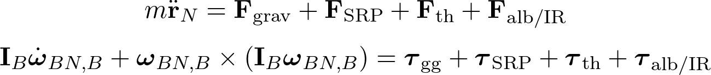
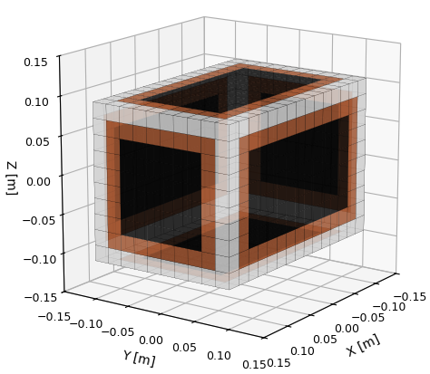
Introduction
Background
Problem
Methodology
Results
Conclusion
Each surface area is assigned, normal direction, reflectivity, absorptivity, emissivity, and thermal reradiation.
Forces and torques are summed per surface.
Notes:
Here is the actual equations for force and torque propagation, which takes into account all of the relevant torques and forces.

Slide 25
Introduction
Background
Problem
Methodology
Results
Conclusion
Gravitational force
and torque
Each surface area is assigned, normal direction, reflectivity, absorptivity, emissivity, and thermal reradiation.
Forces and torques are summed per surface.
Notes:
This includes the gravity of the sun, earth, moon, venus, and Jupiter.

Slide 26
Introduction
Background
Problem
Methodology
Results
Conclusion
Solar radiation force
and torque
Gravitational force
and torque
Each surface area is assigned, normal direction, reflectivity, absorptivity, emissivity, and thermal reradiation.
Forces and torques are summed per surface.
Notes:
Solar radiation pressure based on individual facet sums

Slide 27
Introduction
Background
Problem
Methodology
Results
Conclusion
Solar radiation force
and torque
Gravitational force
and torque
Thermal reradiation
force and torque
Each surface area is assigned, normal direction, reflectivity, absorptivity, emissivity, and thermal reradiation.
Forces and torques are summed per surface.
Notes:
The thermal reradiation of these facets, which some may know as the yarkovsky effect

Slide 28
Introduction
Background
Problem
Methodology
Results
Conclusion
Solar radiation force
and torque
Gravitational force
and torque
Thermal reradiation
force and torque
Each surface area is assigned, normal direction, reflectivity, absorptivity, emissivity, and thermal reradiation.
Forces and torques are summed per surface.
Earth albedo and infrared light force and torque
Notes:
And earth albedo and infrared radiation. This is propagated at a rate of 100Hz with the rk78 integrator.

Slide 29
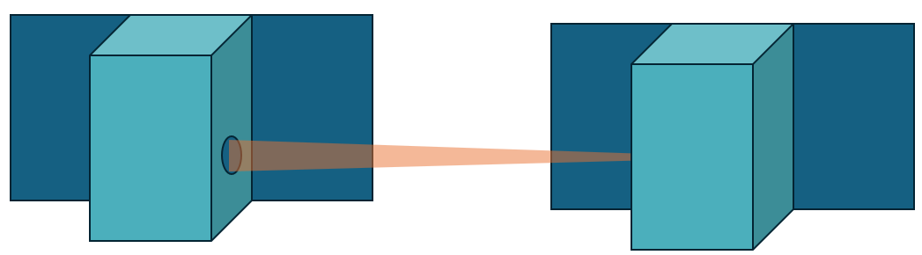
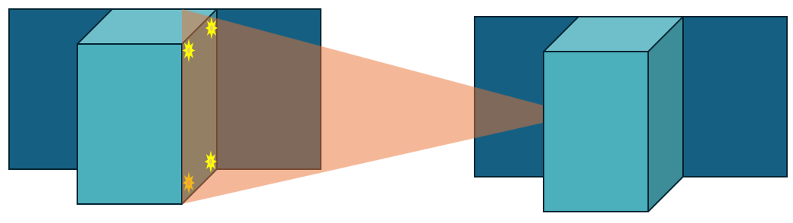
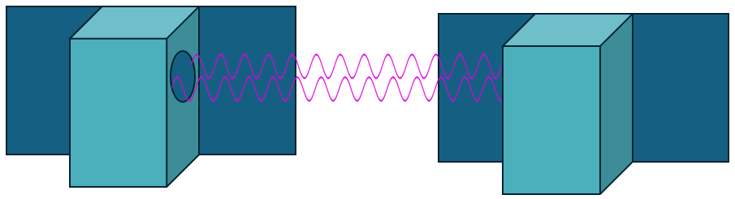
Introduction
Background
Problem
Methodology
Results
Conclusion
Inter-Satellite Sensors
Laser Metrology
LED Centroiding
Inter-Satellite Link
Notes:
High fidelity sensor models are also fundamental to the results in this study. This includes modelling the laser metrology, led centroiding, and inter satellite link

Slide 30
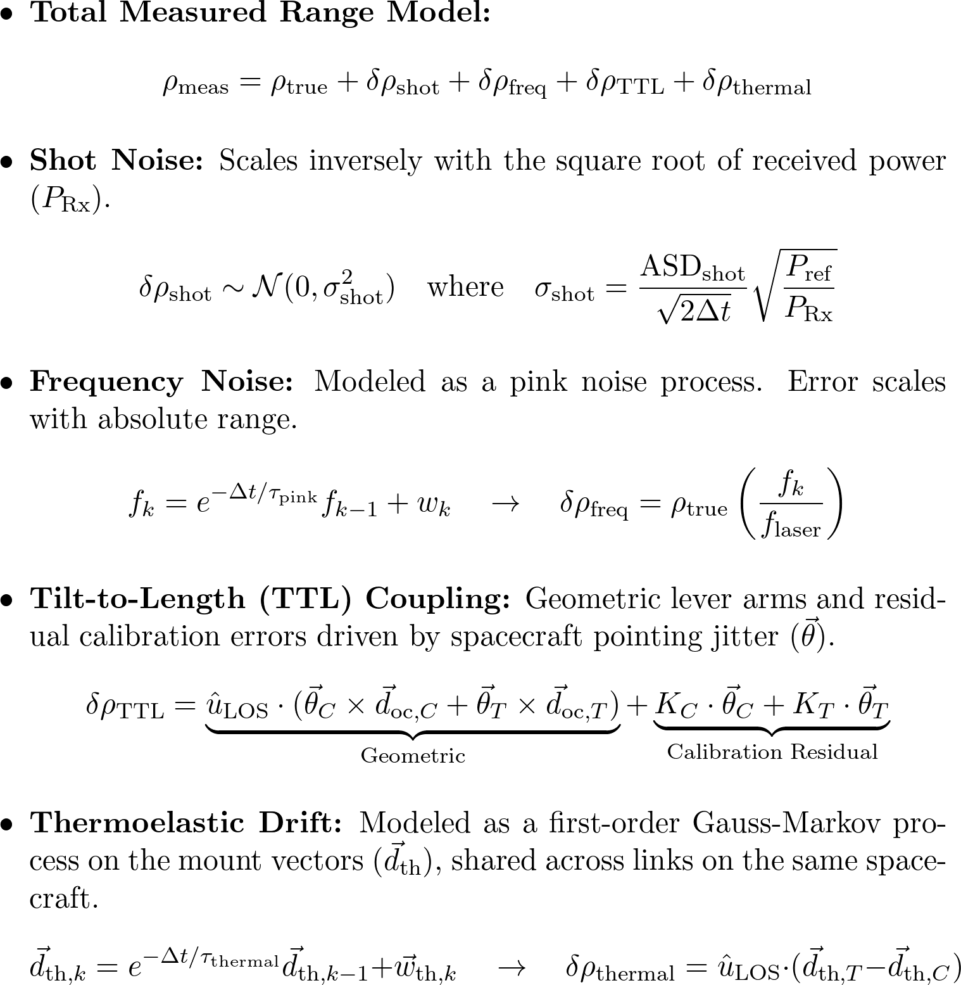
Introduction
Background
Problem
Methodology
Results
Conclusion
Laser Metrology
Radiometric link budget with a white noise draw that scales inversely with the square root of that received power.
Notes:
I don’t have time to go into all the sensors, but a key driver of performance in this study is the laser metrology, so ill go a bit more in depth on how that’s simulated.
So there's 4 different noise sources that I simulate for this sensor. First is a rfull radiometric budget where white nosie scales inversely with the square root of received power.

Slide 31
Introduction
Background
Problem
Methodology
Results
Conclusion
Laser Metrology
Radiometric link budget with a white noise draw that scales inversely with the square root of that received power.
Pink noise signal via a first-order autoregressive process, scaled proportionally to the distance between spacecraft.
Notes:
There is then frequency based noise- for a given wavelength and distance, theres some minimum uncertainty that scales proportionally to the distance between spacecraft as pink noise

Slide 32
Introduction
Background
Problem
Methodology
Results
Conclusion
Laser Metrology
Radiometric link budget with a white noise draw that scales inversely with the square root of that received power.
Pink noise signal via a first-order autoregressive process, scaled proportionally to the distance between spacecraft.
The Path change caused by spacecraft pointing jitter is added to a randomized linear coupling matrix representing lingering post-calibration errors.
Notes:
There is also tilt to length coupling where if the spacecraft’s attitude is jittering, this can be directly seen by the metrology system. This can be calibrated out

Slide 33
Introduction
Background
Problem
Methodology
Results
Conclusion
Laser Metrology
Radiometric link budget with a white noise draw that scales inversely with the square root of that received power.
Pink noise signal via a first-order autoregressive process, scaled proportionally to the distance between spacecraft.
The Path change caused by spacecraft pointing jitter is added to a randomized linear coupling matrix representing lingering post-calibration errors.
Simulated via a first-order Gauss-Markov random walk applied directly to the body-frame metrology head mounting vectors.
Notes:
But given the fourth noise source, thermal drift can cause the calibration to be off.
So this hopefully gives you an idea of the level that the sensors are simulated to.

Slide 34
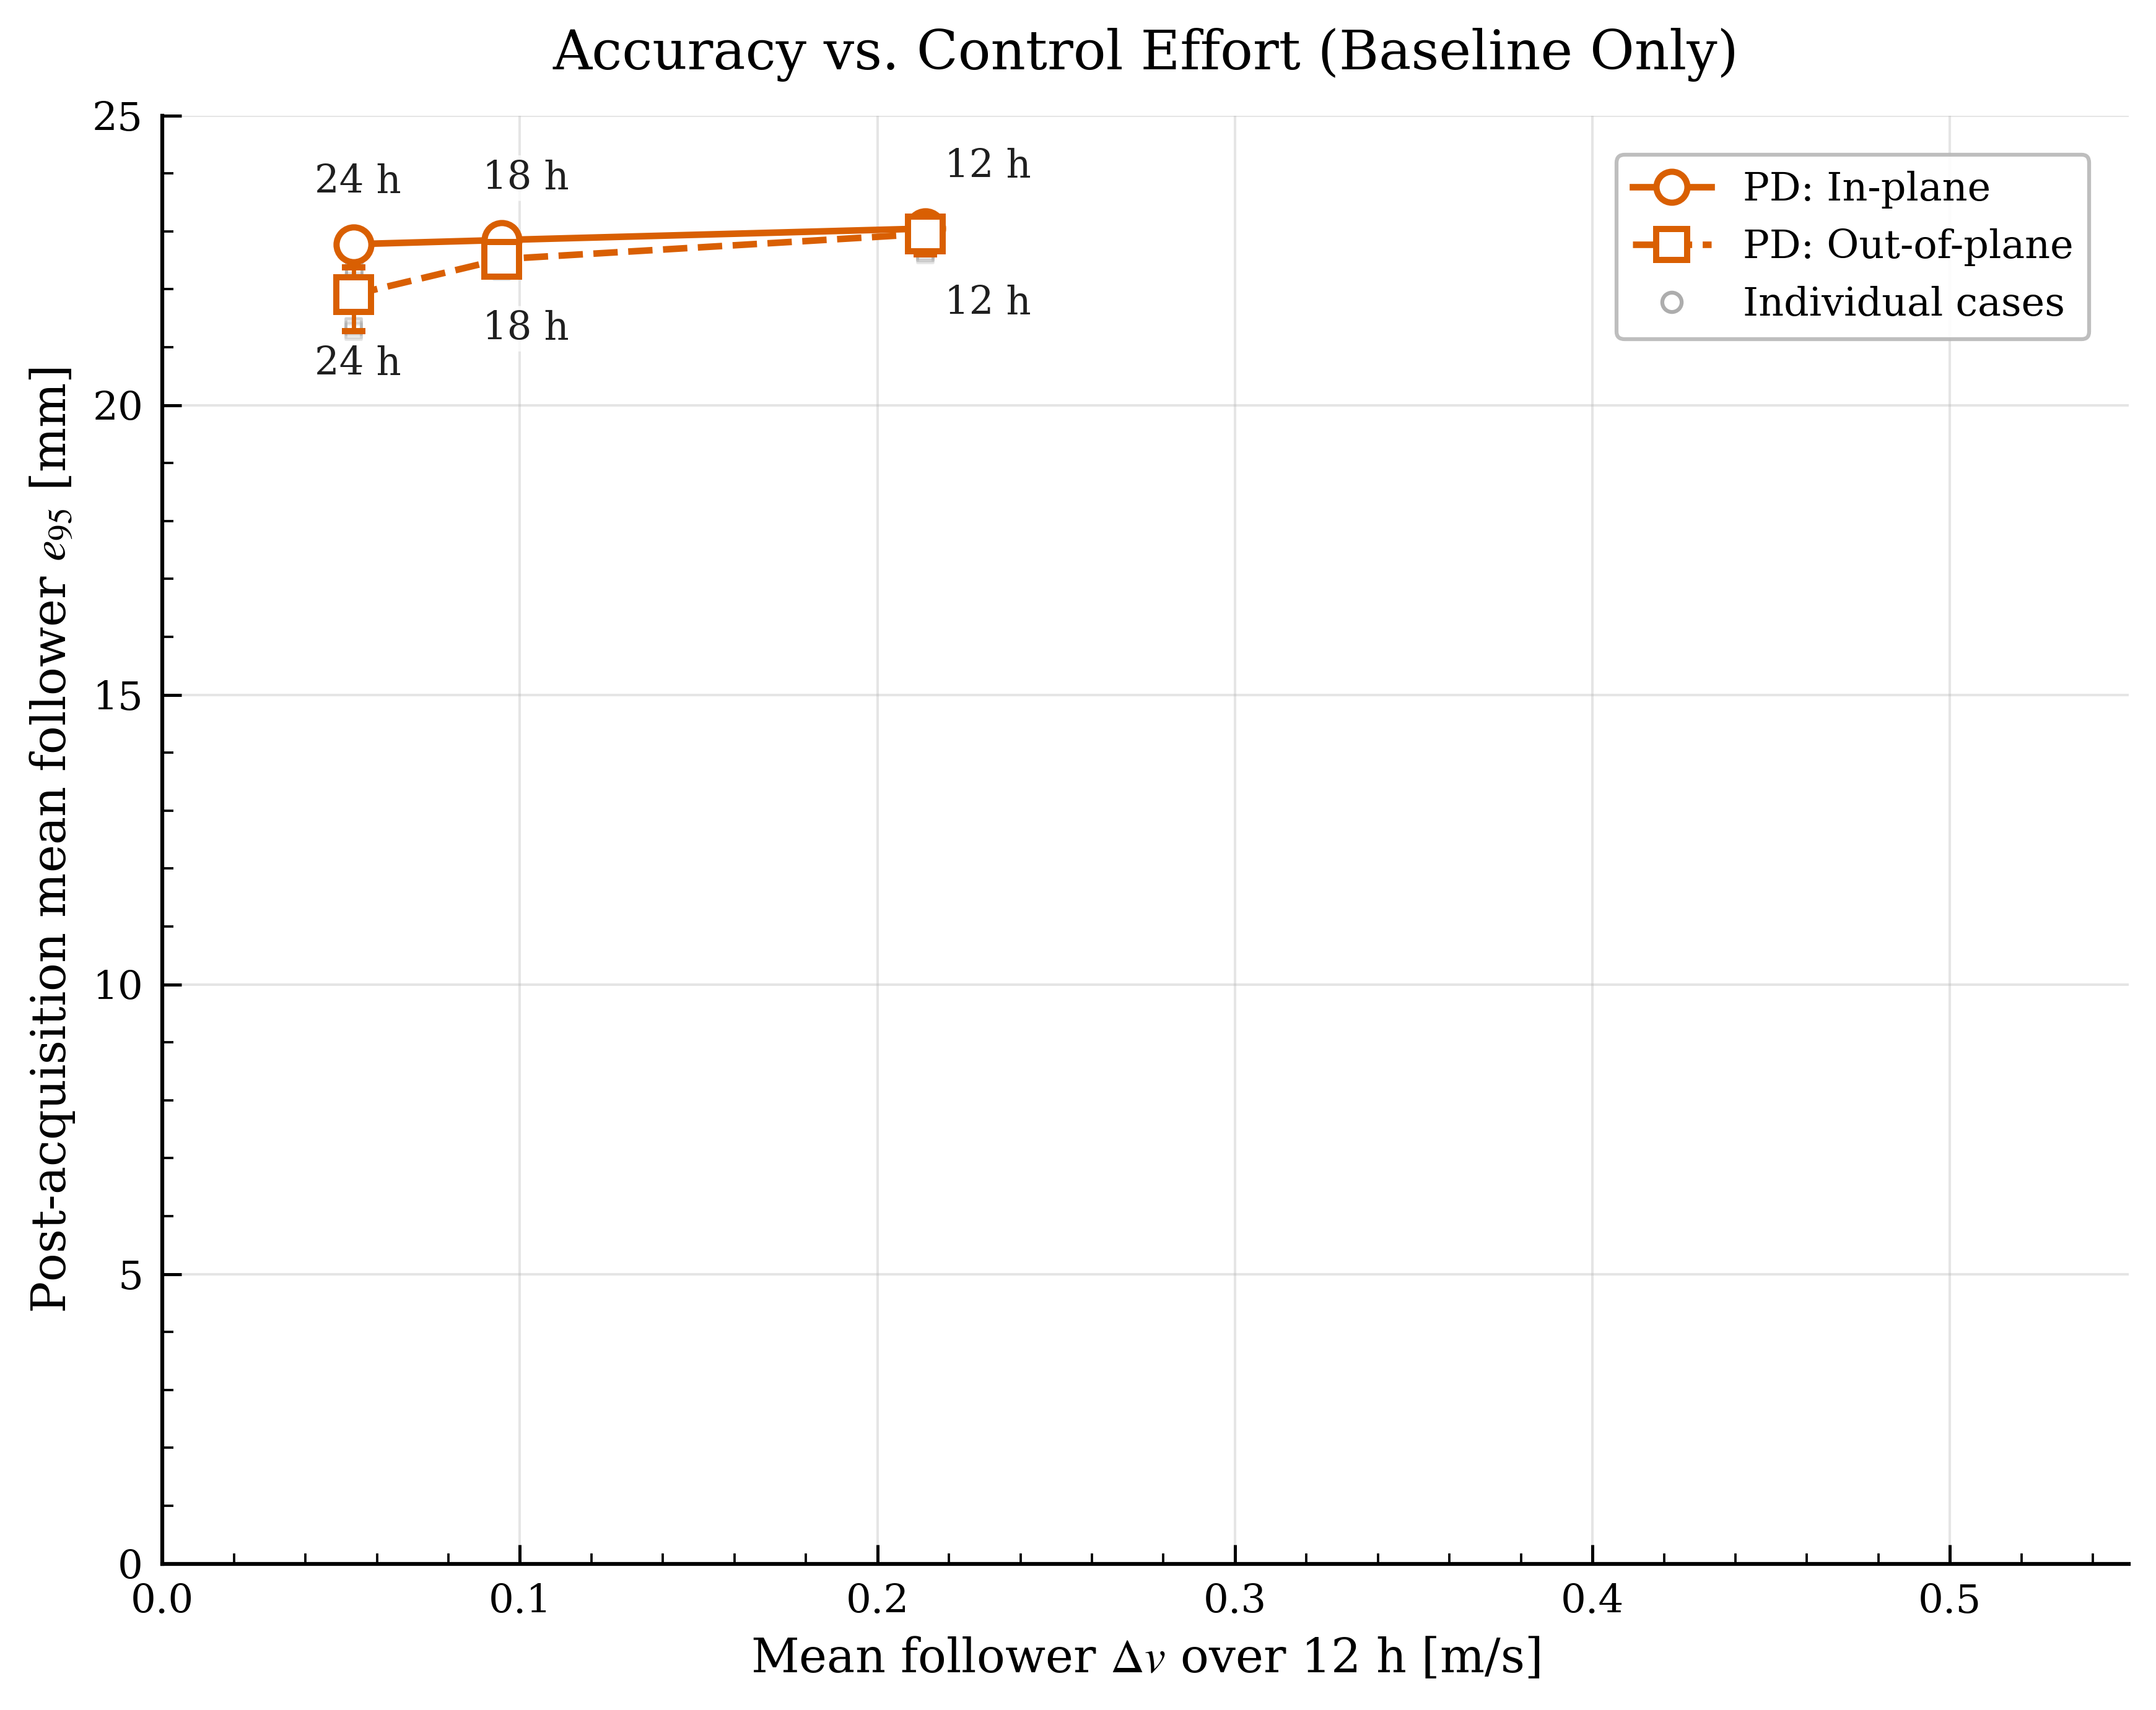
Introduction
Background
Problem
Methodology
Results
Conclusion

Slide 35
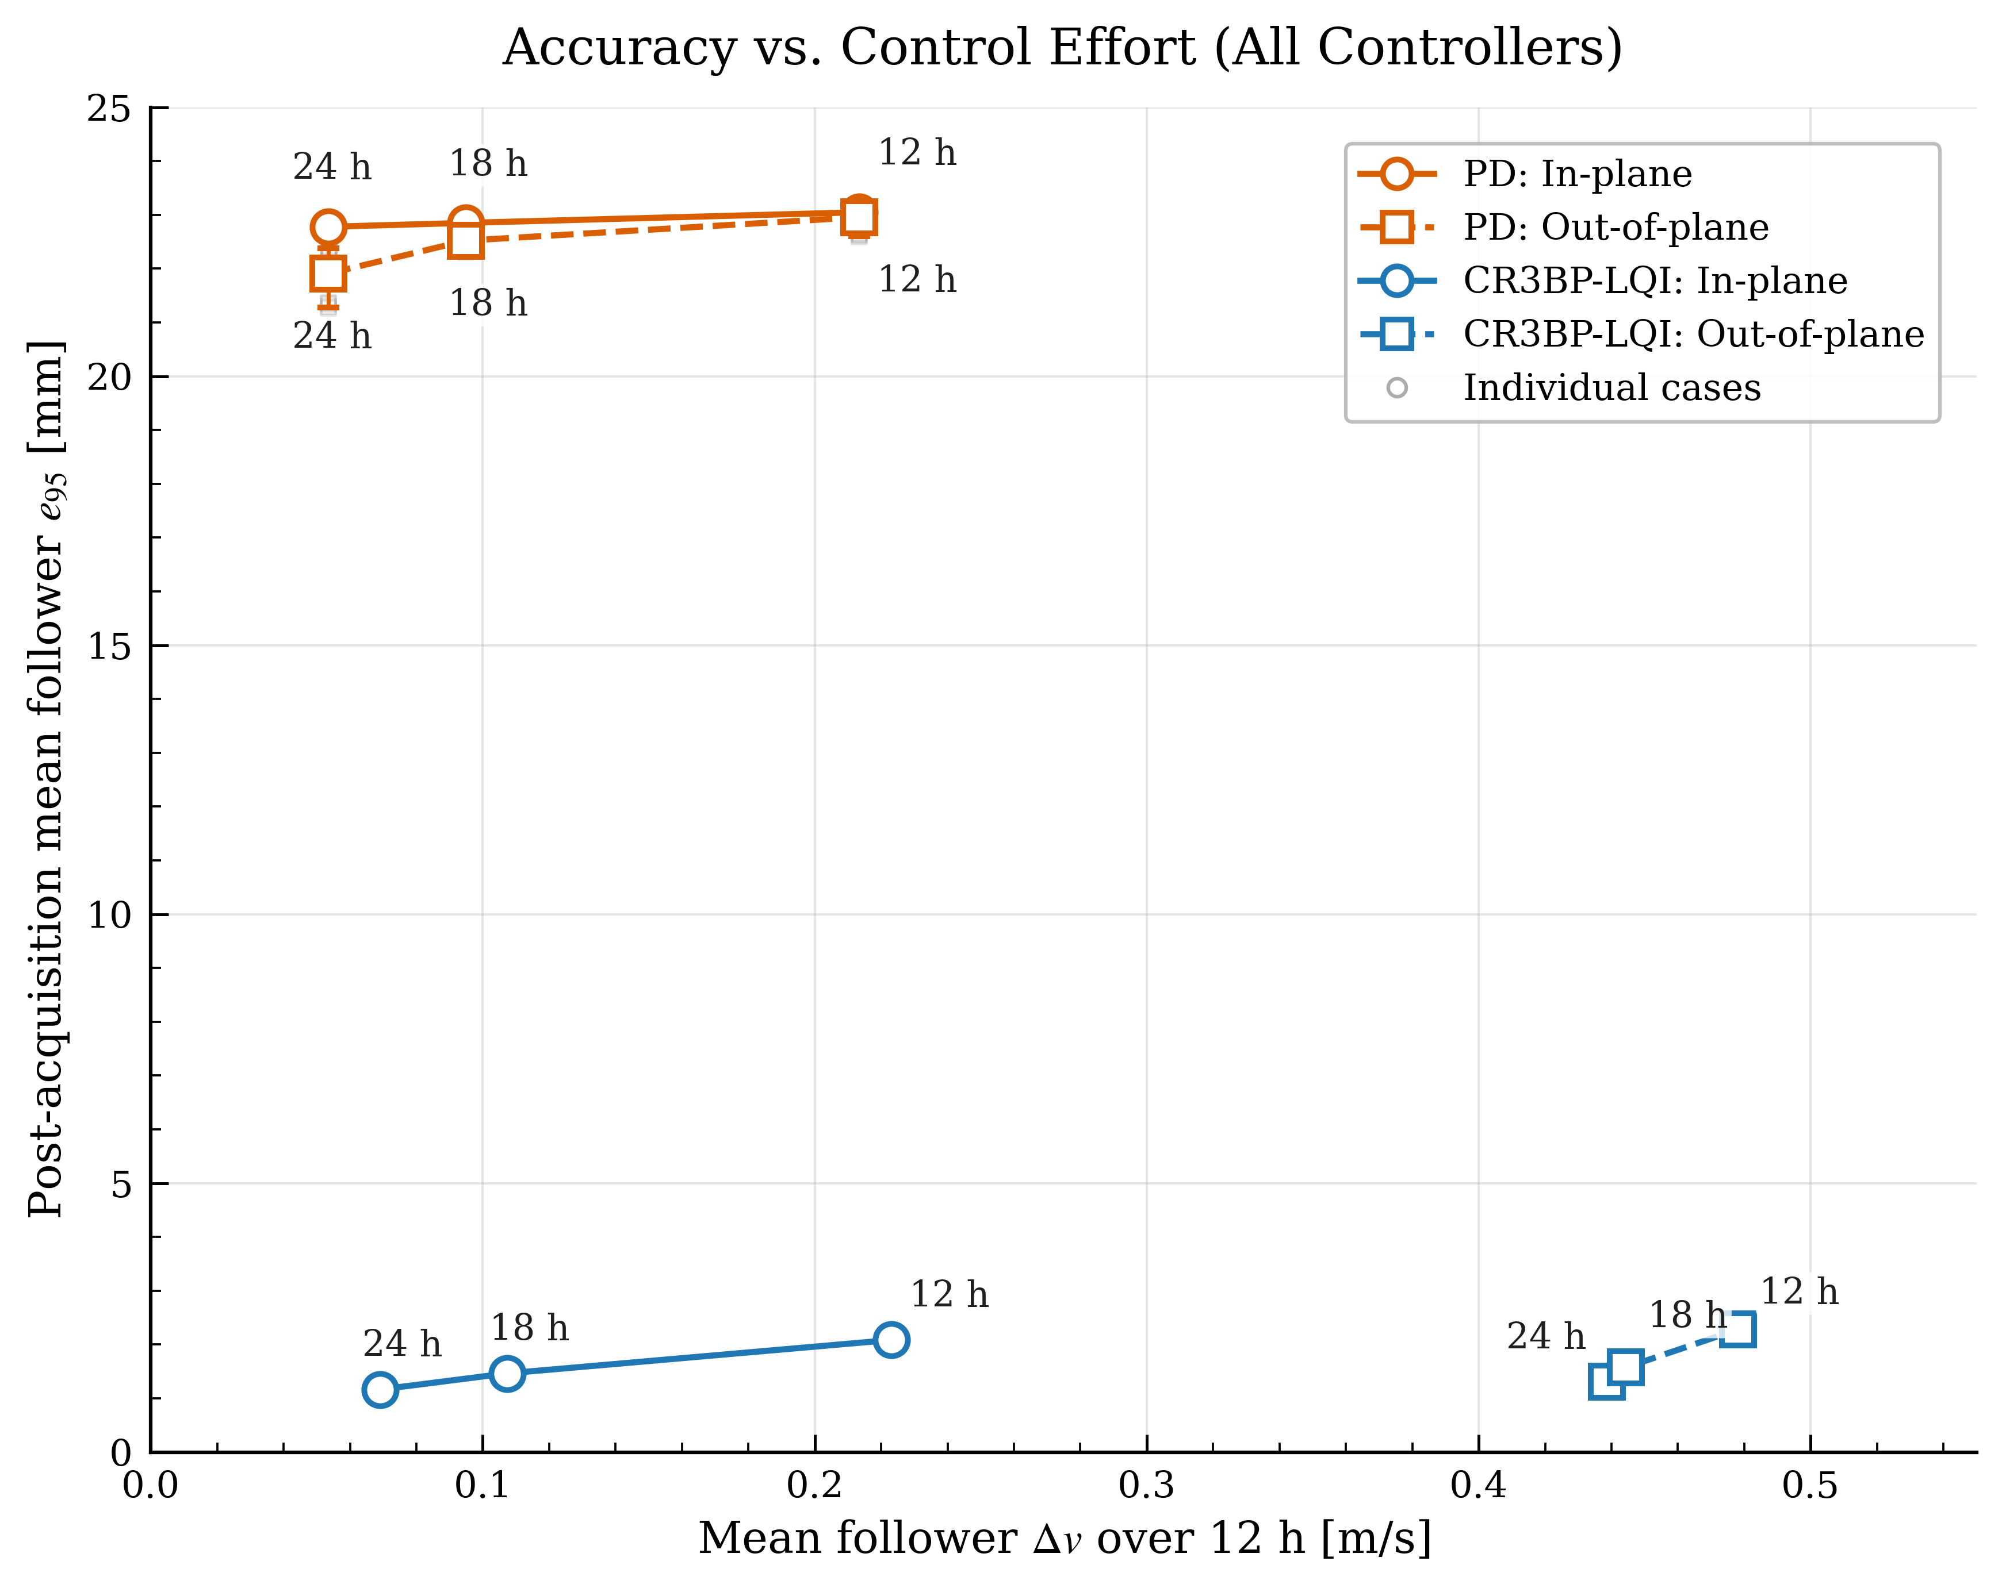
Introduction
Background
Problem
Methodology
Results
Conclusion
Controller selection sets the accuracy–propellant trade
Array-rotation period is the common Δv driver
In- vs out-of-plane affects the LQI controller only

Slide 36
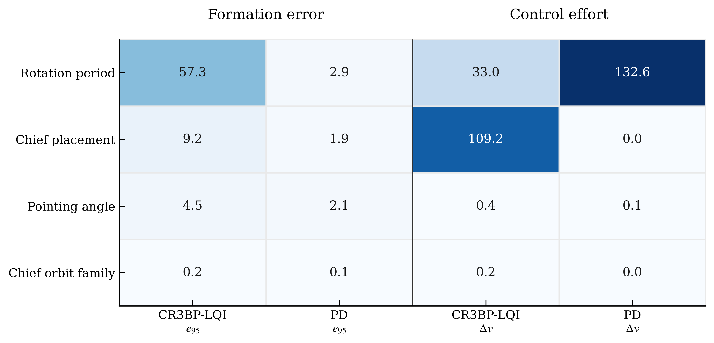
Introduction
Background
Problem
Methodology
Results
Conclusion
Relative Factor Sensitivity Percentages
Notes:
So presented differently, this shows the relative sensitivity of each trade variable. you can
For delta-v, the thing that matters are the rotation rate for both controllers, and for the lqi, the chief placement matters more due to the degradation in sensor performance.

Slide 37
Introduction
Background
Problem
Methodology
Results
Conclusion
Key Takeaways
GNC and optical control must be co-designed: Formation errors couple directly into optical-path difference and planet-modulation error.
Controller selection sets the accuracy–propellant trade: CR3BP–LQI achieved 1–2 mm error, but came with the cost of higher Δv; with LQI, the out-of-plane combiner adds a large Δv penalty.
Array-rotation periods are the common Δv driver: Array rotation periods raise Δv, and substantially increase LQI formation error. Pointing angle and chief-orbit family were secondary.
Any Questions?
Aiden Weatherbee, MSc, Astronautics and Robotics Laboratory (ASTRO Lab),
York University, Email: aidenweatherbee@hotmail.com
Notes:
Thanks for attending my presentation. I welcome any questions

Slide 38
References
Cockell, C. S., Léger, A., Fridlund, M., et al., "Darwin—A Mission to Detect, and Search for Life on, Extrasolar Planets," Experimental Astronomy, Vol. 23, Nos. 1–2, 2009, pp. 435–461
Lawson, P. R., et al., "Terrestrial Planet Finder Interferometer (TPF-I): Response to Astro2010 Request for Information for Proposed Activities," Jet Propulsion Laboratory, Pasadena, CA, March 2009. URL: https://www.astro.princeton.edu/~dns/FRS120/RFI/134_TPF-I_Lawson_EOS.pdf
European Space Agency, "Darwin's six telescopes," ESA Multimedia, June 2015. URL: https://www.esa.int/ESA_Multimedia/Images/2015/06/Darwin_s_six_telescopes
European Space Agency, "Proba-3," ESA Space Engineering & Technology. URL: https://www.esa.int/Enabling_Support/Space_Engineering_Technology/Proba-3
Space Rendezvous Laboratory, "STARI," Stanford University. URL: https://slab.stanford.edu/projects/stari
National Aeronautics and Space Administration, "GRACE-FO," NASA Science, November 2025. URL: https://science.nasa.gov/mission/grace-fo/
Gargaud, M., et al. (eds), Encyclopedia of Astrobiology, Springer, Berlin, Heidelberg. DOI: 10.1007/978-3-642-27833-4_1088-3. URL: https://link.springer.com/rwe/10.1007/978-3-642-27833-4_1088-3

